Slide 1




A Survey of Features in Visual IDEs for Non-Programmers from a Usability and Suitability Point of View
Jean Michel Rouly¹, Jonathan Orbeck², Dr. Eugene Syriani³
¹ George Mason University, Fairfax, Virginia, United States
² University of Alabama, Tuscaloosa, Alabama, United States
³ Université de Montréal, Montréal, Quebec, Canada

Slide 2
Research Question
What aspects of a visual programming IDE affect
usability? Can these features be standardized?
{1}

Slide 3
Background
Integrated Development Environments (IDEs)
Visual languages
Interface design
{2}

Slide 4
Background
IDEs
An Integrated Development Environment ...
is generally domain specific
supports development process
integrates tools in uniform interface
A.N. Habermann and D. Notkin. Gandalf: Software development environments. Software Engineering, IEEE Transactions on, SE-12(12):1117{1127, Dec 1986. ISSN 0098-5589. doi: 10.1109/TSE.1986.6313007.
{3}

Slide 5
Background
Visual Languages
A visual language ...
uses pictures to express computations
consists of visual vocabulary, grammar, and semantics
is more effective than text
D.L. Moody. The physics of notations: Toward a scientific basis for constructing visual notations in software engineering. Software Engineering, IEEE Transactions on, 35(6):756–779, Nov 2009. ISSN 0098-5589. doi: 10.1109/TSE.2009.67.
Eric J Golin and Steven P Reiss. The specication of visual language syntax. Journal of Visual Languages
& Computing, 1(2):141{157, 1990.
{4}

Slide 6
Background
Interface Design
Software Interfaces ...
understand user desires and requirements
plan for domain opportunities and constraints
create useful, usable, and desirable products
Alan Cooper, Robert Reimann, and David Cronin. About face 3: the essentials of interaction design. John Wiley & Sons, 2007.
{5}

Slide 7
Research Proposal
Select visual IDEs
Define features
select common IDE features
formalize definitions
establish value ranges
Evaluate IDEs
measure IDEs for each feature
conduct user study for qualitative features
Prototype development framework
{6}

Slide 8
Select Visual IDEs
{7}

Slide 9
IDEs by Domain
3D Modeling
Blender
Grasshopper 3D
Software
EMF
GNU Radio Companion
AppInventor
Piet Creator
Scratch
Stencyl
Tersus
TouchDevelop
WebRatio
Music
AudioMulch
Max
Animation
Alice3
Prototyping
Cameleon
Modeling
AToMPM
MetaEdit+
UMLet
Violet
Visual Paradigm
Visual Use Case
Simulation
MST
SimuLink
VisSim
Workflow
YAWL
{8}

Slide 10
Define Features
{9}

Slide 11
IDE Features
Define novel set of features
Categories
Audience
Chrome
Human Interface
Integration
Language Syntax
{10}
Notes:
Audience = relates to target population of the IDE
Chrome = all interface components external to the workspace
Human Interface = how the user interacts with the IDE
Integration = how the IDE integrates with its visual language
Language Syntax = properties of the supported visual language syntax

Slide 12
IDE Features
Audience
Domain
field of knowledge
eg. 3D modeling, animation, music, software, etc.
Skill Level
requisite entry-level skill
eg. novice, intermediate, expert, general
{11}
Notes:
Domain = field for which the interface is primarily used
Could be for anything, not just programming
Skill level = expected skill level within the domain of use
Because we are looking for accessibility within an IDE, a general skill level is ideal
-powerful functionality yet welcoming for new users

Slide 13
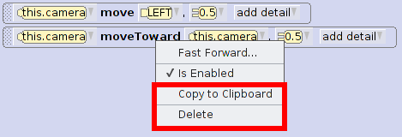
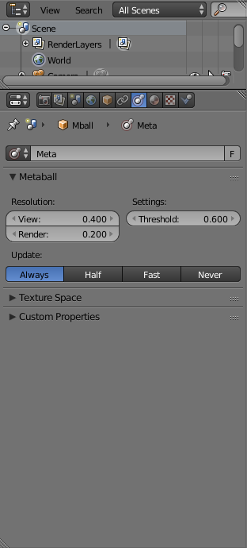
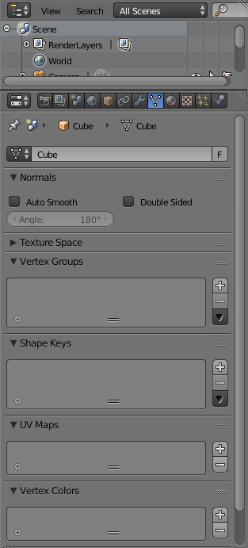
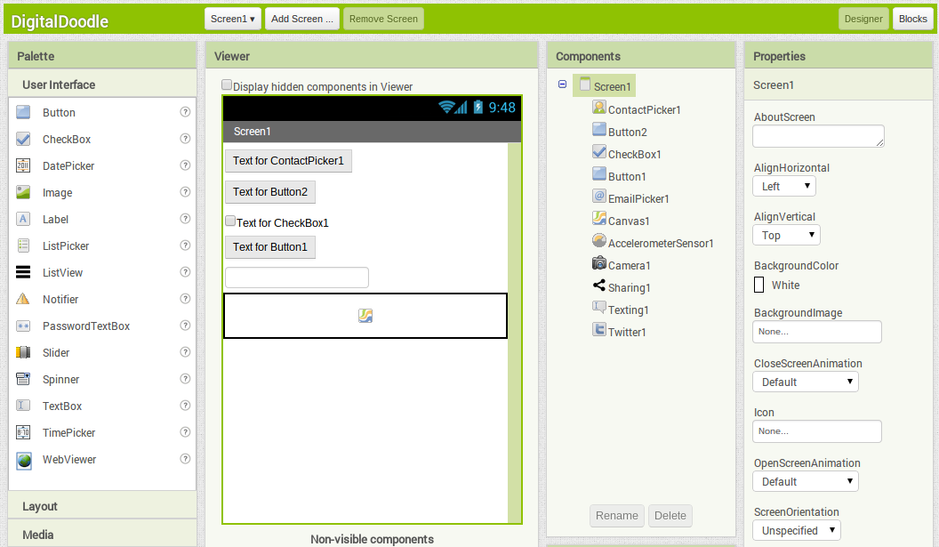
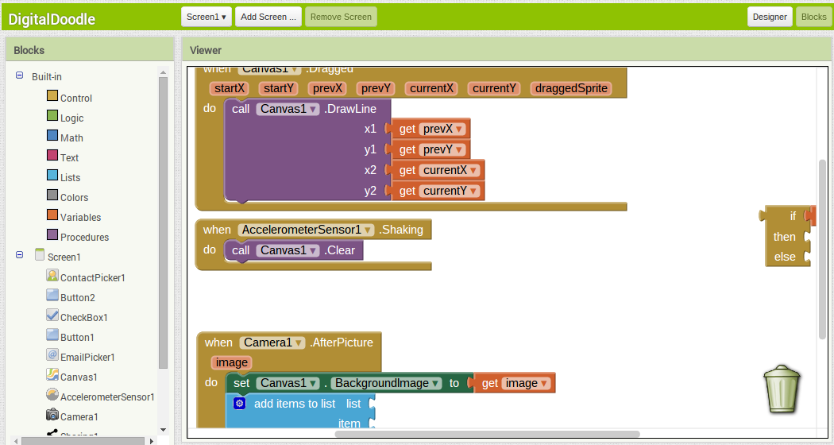
IDE Features
Chrome
Popular Features
most frequently used IDE features
includes delete, save, paste, content assist, etc.
Context Sensitive Tools
tools that change given context
Multiplicity of Perspectives
number of available predefined tool configurations
G.C. Murphy, M. Kersten, and L. Findlater. How are java software developers using the Eclipse IDE? Software, IEEE, 23(4):76–83, July 2006. ISSN 0740-7459. doi: 10.1109/MS.2006.105.c
{12}
Notes:
Popular Features is derived from Gale Murphy’s article which defines a list of the top 10 most frequently used IDE features
Delete, Save, Paste, Copy, Undo, Cut
We applied this list to the various IDEs we studies and counted how many of the features were supported to create an aggregate value for comparison
The higher the number of features, the more it meets developer expectations
Context sensitive tool = different tools available depending on which elements are selected
Offers a simple method of allowing more in depth management of the model
Perspectives = the number of available predefined interface perspectives
A large amount of perspectives can support modularization and offer different methods with which to view data

Slide 14
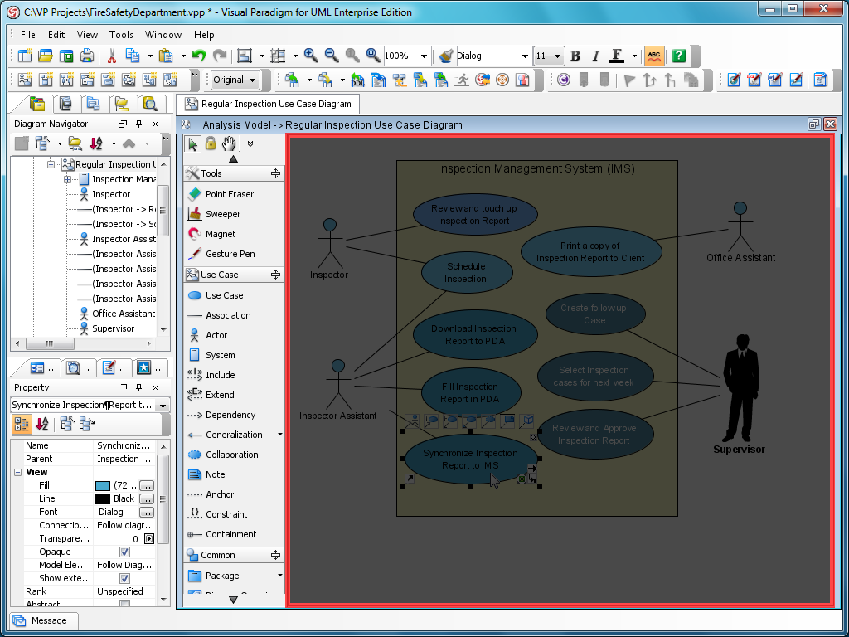
IDE Features
Chrome
Degree of Interface Visual Richness
increase visual discriminability between tools
eg. icons, shape, size, color, etc.
Visual Clutter
the number and organization of tools on the screen
qualitative metric
D.L. Moody. The physics of notations: Toward a scientific basis for constructing visual notations in software engineering. Software Engineering, IEEE Transactions on, 35(6):756–779, Nov 2009. ISSN 0098-5589. doi: 10.1109/TSE.2009.67.
{13}
Notes:
Derived a set of variables from Moody’s Physics of Notations which increase visual discriminability between objects
The number of features present in the interface were counted and used as the value
Having a high number is better
icons, shape, size, color, text, coherence, texture, brightness
Clutter = qualitative variable to measure the amount and organization of on-screen tools versus the amount of workspace

Slide 15
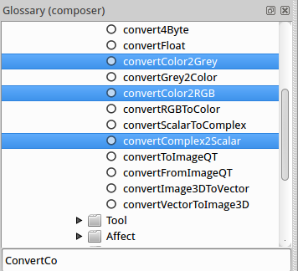
IDE Features
Chrome
Object Properties Window
display mode of object properties dialog or window
Searchable Toolspace
available tools can be reached through searching
Toolbar Styles
interface component idioms
eg. sliders, toolbars, trees, icons, etc.
{14}
Notes:
Object properties window = interface component that displays and allows modification of canvas element properties
Onipresent, manual, more beneficial than none
Searchable toolspace = library of tools can be searched through by name or keyword
Allows easy management of a huge array of tools
Toolbar styles = different utilized toolbar interaction styles

Slide 16
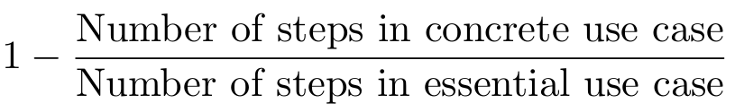
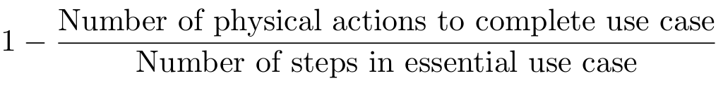
IDE Features
Human Interface
Essential Efficiency
amount of mental load to complete a standardized task
Interface Efficiency
amount of physical action to complete a standardized task
L.L. Constantine. “Usage-centered software engineering: new models, methods, and metrics ”. In Software Engineering: Education and Practice, 1996. Proceedings. International Conference, pages 2–9, Jan 1996. doi: 10.1109/SEEP.1996.533974.
{15}
Notes:
For efficiency, we created essential use cases of varying complexity to test each of the IDEs
Essential efficiency = number of steps the user mentally processed to complete the use case (concrete use case)
Interface efficiency = number of user actions required to complete the use case
High eficiency good

Slide 17
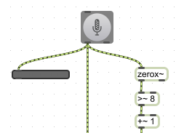
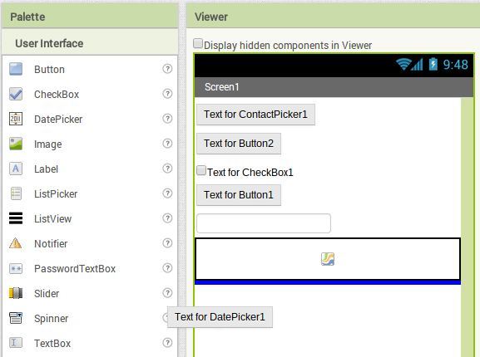
IDE Features
Human Interface
Keyboard Use
level of interface support for keyboards
Tertiary Interface Devices
level of interface support for third-party devices
Mode of Element Creation
process to create elements in workspace
eg. drag n drop, point n click
{16}
Notes:
Keyboard use = degree to which the IDE implements a keyboard
simple, optional, required
Optional ideal
Tertiary interface devices = any support for external devices
Mode of Element Creation = style of element creation on the workspace
Drag and drop, point n click, same number of steps if (1:1), (1:n) is better

Slide 18
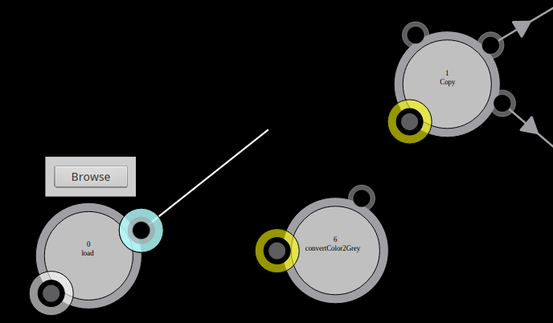
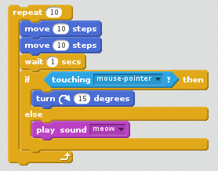
IDE Features
Integration
Allowed Relations Indicated
syntactically correct connections highlighted
Output Generation Style
relationship between user-created model and final output
Syntax Enforcement
how the IDE enforces language syntax
explicit vs implicit enforcement
{17}
Notes:
Allowed relations indicated = an IDE’s ability to emphasize possible syntactically correct connection points (i.e. highlighting, color)
Its presence is able to reduce mental load on the user
Output Generation Style = the mode with which the IDE renders and displays output to the user
Direct = modifications directly alter the output
Live = output dynamically updated, trigger requires compilation or execution
Syntax enforcement = mode with which the IDE enforces the language’s syntax
Explicit = displays a message, implicit = syntax of the language prevents user from making an error
Both good, implicit preferred

Slide 19
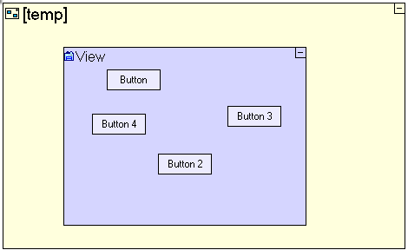
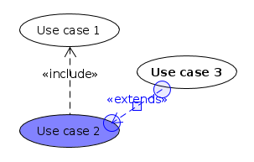
IDE Features
Language Syntax
Complexity Management
characteristics to reduce language complexity
Connection Style
mode by which connections are created and displayed
Degree of Language Visual Richness
used to increase visual discriminability between elements
eg. icons, shape, size, color, etc.
{18}
Notes:
complexity management = features that serve to reduce the diagrammatic complexity while maintaining information transfer to the user
Modularization = larger systems within the language are divided into smaller subtasks
Hierarchy = different systems within the language are represented at different levels of detail
Beneficial if present
Connection style = describes the manner that element connections are created and displayed
Overlapping = connected by positioning elements to overlap, linked = how it sounds
geometric = connected via geometric placement
Takes the concepts of interface richness and applies them to the visual language, with a few different values to compliment the change in medium

Slide 20
Evaluate IDEs
{19}

Slide 21
Data Collection
Measure IDEs
for each IDE, measure values of each variable
some variables required in-depth analysis
essential & interface efficiency
visual clutter
{20}

Slide 22
Data Collection
Efficiency
Create essential use cases
3 for each IDE
increasing amount of complexity
highest tier determined to be most representative
Assess concrete use cases
concretely execute each use case
record steps & physical actions
{21}

Slide 23

Data Collection
Visual Clutter
User study performed on Amazon.com Mechanical Turk
workers rated screenshots for clutter
3 screenshots per IDE, varying complexity
5 unique workers per screenshot
calculated averages for final values
inter-rater reliability good, ICC=0.648
{22}
Notes:
Clutter = qualitative variable to measure the amount and organization of on-screen tools versus the amount of workspace
In order to measure this, we set up a user study on Amazon’s mechanical turk program
Workers would look at a screenshot of an IDE and rate how cluttered it looked to them
3 screenshots of varying complexity for each IDE, limited to 5 unique workers each
averaged the ratings for each screenshot, then averaged the ratings for each IDE
Given the fact that each screenshot had multiple raters, we ran an inter-rater reliability metric
speciffically an intra-class correlation coefficient based on an agreement metric - similarity between raters
result was a .648, which is considered to be a “good” rating

Slide 24
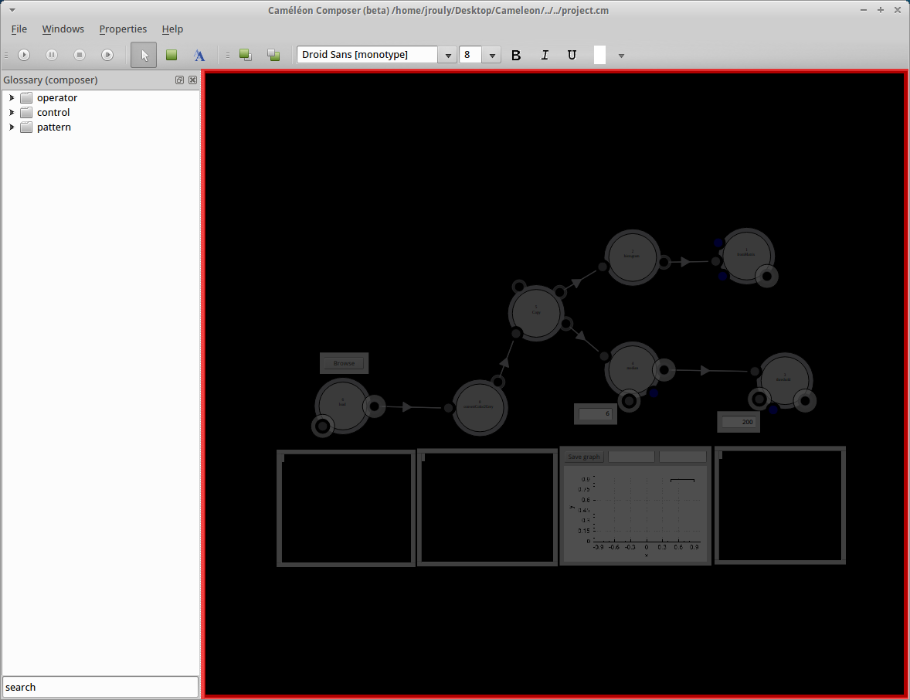
Data Collection
Visual Clutter
{23}
Notes:
This chart is a visual representation based on the ratings of the individual screenshots for each IDE. Scale of 1 - 5

Slide 25
Prototype Development Framework
{24}

Slide 26

AToMPM is “a research framework from which you can generate domain-specific modeling web-based tools that run on the cloud”
E. Syriani, H. Vangheluwe, R. Mannadiar, C. Hansen, S. Van Mierlo and H. Ergin. AToMPM: A Web-based Modeling Environment. MODELS'13: Invited Talks, Demos, Posters, and ACM SRC. CEUR-WS.org: 1115, Miami, U.S.A., oct (2013).
{25}

Slide 27
Contributions
guided by results of IDE analysis
intended to increase ease of use
developed API Plugin
extract common interface actions
decrease required system familiarity for end user
API.openModelViewer // Open model selection dialog
API.fireStatechart // Broadcast a known event to Statecharts
API.drawElement // Draw a custom canvas element
API.deleteElement // Delete a canvas element by ID
API.drawEdge // Construct an edge between two elements
API.dotConvert // Convert a filepath to ArkM3 notation
{26}

Slide 28
Outcomes and
Future Work
{27}

Slide 29
Outcomes
Set of formal interface feature definitions
Evaluation technique for new IDEs
Paper detailing results
Foundation for AToMPM API
{28}

Slide 30
Future Work
AToMPM
generalize functions to AToMPM API
incorporate visual variables
complete user study of platform usability
IDE Survey
complete user studies of more variables
perform statistical analysis & validation of results
add more IDEs, develop more features of analysis
{29}

Slide 31
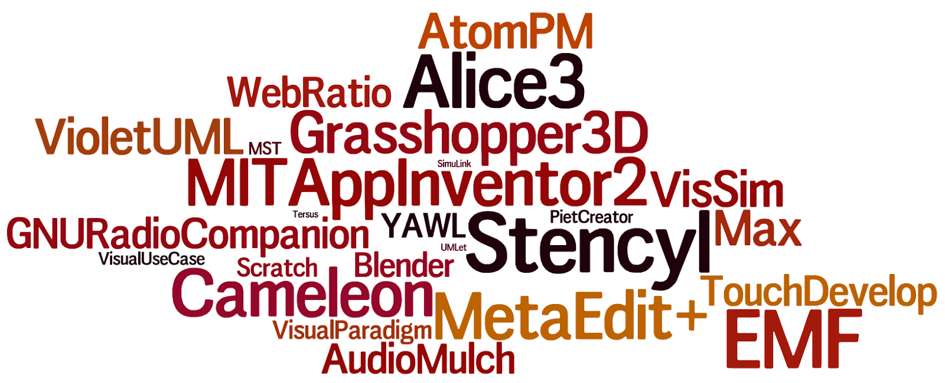
Questions?
{30}

